Slide 1

BANK PRODUCT UPTAKE PREDICTION
The goal of this project is to predict if a Client will subscribe to a Term Deposit or Not.
A Term Deposit account is a type of deposit account held at a financial institution with money in it for a set period.
. Data Cleaning
. Exploratory Data Analysis
. Classification and Cross Validation
Chiamaka Ihenwe

Slide 2
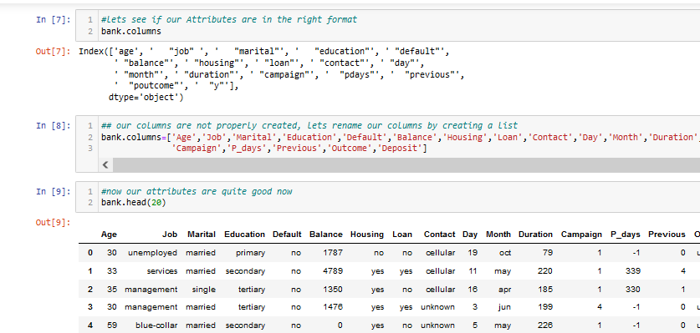
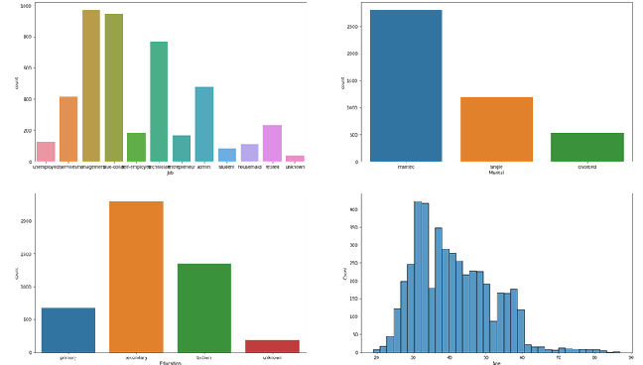
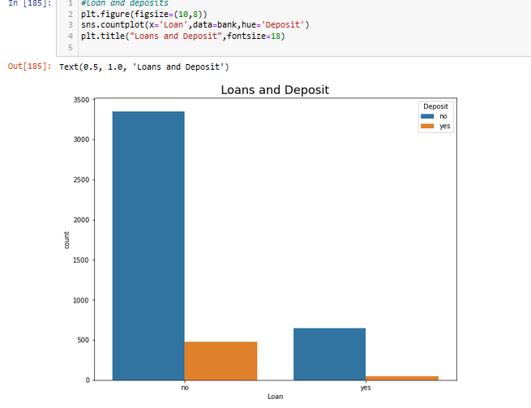
Data Cleaning & EDA:
No Missing data
No duplicates
Column names was renamed correctly as seen in the screenshot below.
90% of bank clients in our data set have management jobs followed by blue collar job.
From our data set, we have more married clients than single and divorced clients.
Most of our Bank clients obtained secondary education.
- client's without personal loans subscribed more for term deposits

Slide 3
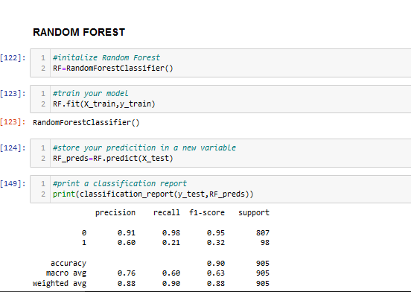
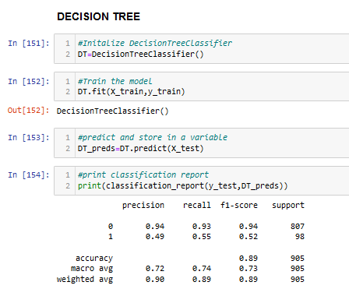
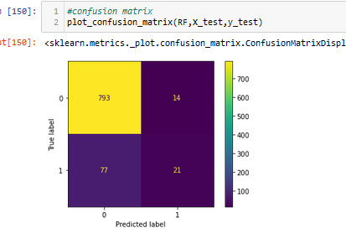
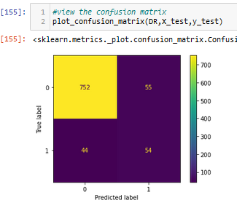
Building Models
Using different algorithms
Train and test split with the test size of 0.2(80:20)
Precision and Recall
Classification report
Accuracy score and confusion matrix

Slide 4
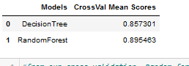
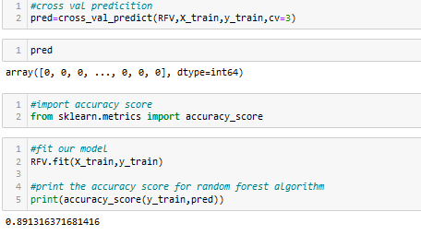
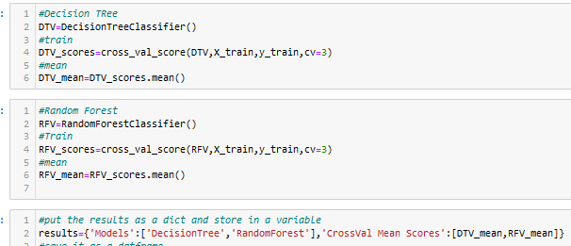
Cross Validation of Random Forest and Decision Tree due to overfitting
Random Forest has a cross validation score of 89% and an accuracy score of 89%
Random forest is the model for this prediction.

